Slide 1
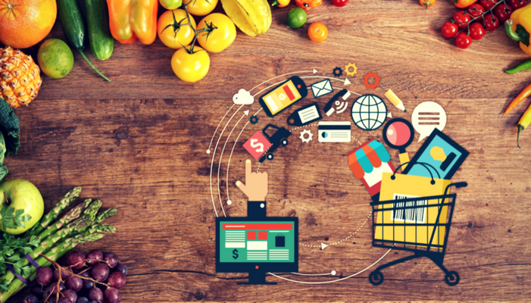
Grocery Management System
GROCEKART
By-Aman Saini
Shubham Sethi
Piyush Raj
Gaurav Bisht
Ujjwal Kumar Maneriya

Slide 2
Software and Tools
Eclipse
My Sql
Apache Tomcat
CSS
HTML 5
Java Advance J2EE

Slide 3
Content
Introduction
Abstract
Existing System
System and Software Requirements.
System Architecture.
Conclusion
Refrence

Slide 4
Introduction
Grocery Management System.
A grocery store is a retail stores that primary sells food. A grocer is a bulk seller of food.
As a pollution around the world is increased buying food on the road side is not advisable.
Nasscom Foundation and Centum Learning.
The project is completed under the six weeks training which is supported by the Nascom Foundation.
The training is provide by the centum learning.
Training project is sponsored by Altran.

Slide 5
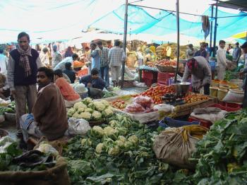

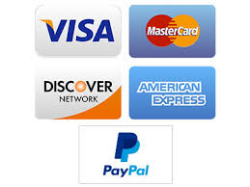
Grocery Management System
Traditional
Saving time and energy.
Also get rid from rush.
Easy payment options like debit card,paypal,visa card etc.
Ease of delivery convenience.
Home delivery facility.

Slide 6
Abstract
“Health is wealth”.As the saying goes from ancient times.As of now a days it is very difficult to have healthy food.
People are unable to find time to household works like buying grocery.So by this platform we provide grocery.
This is a internet based application that can be accessed through the web.
This system can be used to search for all grocery and fresh vegetables which are available in the market.

Slide 7
Existing System
Grocery Stores often offer non-perishable foods that is packaged in cans, bottles and boxes with some also having fresh produce butchers delight and bakeries.
As pollution around the world has increased the buying the food on the road side in not advisable.
The consumption of unhygienic food from the direct grocery stores and there is no parameter to check it.

Slide 8
System and Software Requirements.
Hardware Requirements
System : Pentium IV 2.4 GHz.
Hard disk : 40 GB.
Ram : 512 MB.
Software Requirements
Operating System : Windows XP.
Coding Language : J2EE.
Database : MY Sql.

Slide 9


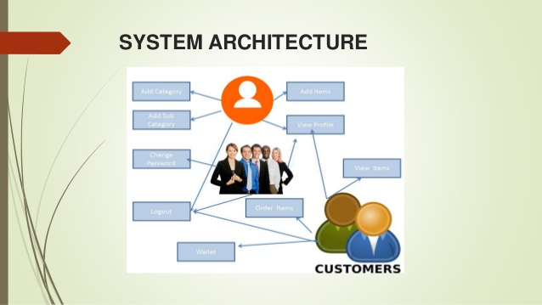
System Architecture.
Add Category
Sign Up
For new User
Add Sub Category
Login for the Existing User
Change Presentation
Other Items
View Items
Logout
Wallet

Slide 10


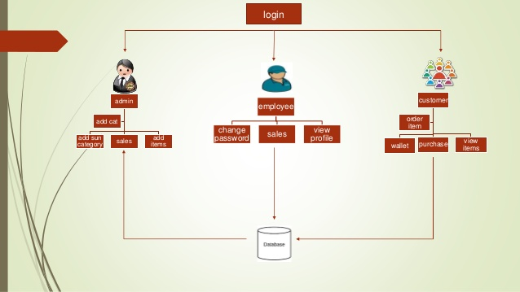
LOGIN
Admin
Employee
Customer
Order
View Profile
Change Profile
Sales
Add Sub Category
Sales
Add Item
Wallet
Purchase
View
Item

Slide 11
Conclusion
By Implementing this grocery management system we are getting the more flexibility for the users.
Which can operate from the home itself by implementing the pay and pickup and paynow options.

Slide 12
Refrence
www.google.com
Industry Profile:Grocery Store and Supermarket available at www.grofers.com

